Slide 1
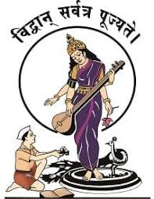
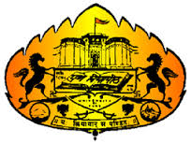
PVG's College of Engineering and Technology & G. K. Pate (Wani) Institute of Management, Pune. Department of Information Technology
Final Year Project Presentation
On
Personality Prediction Using Machine Learning
By
Hritik Koul
Raviraj Kokare
Ishwari Pawar
Nikhil Chaudhari
Guide
Prof. M.R. MAHAJAN SIR

Slide 2
Personality Prediction Using Machine Learning
Contents
Project Details
Project Motivation
Introduction
Literature Survey
Proposed System
Architecture Diagram of Proposed System
UML Diagrams
System Requirements
Applications/Advantages
Conclusions
References
PVG's College of Engineering and Technology & G. K. Pate (Wani) Institute of Management, Pune.

Slide 3
Personality Prediction Using Machine Learning
Project Details
Project Title: Personality Prediction Using Machine Learning
Project Domain: Artificial Intelligence
Project Group Members:
Hritik Koul
Raviraj Kokare
Ishwari Pawar
Nikhil Chaudhari
PVG's College of Engineering and Technology & G. K. Pate (Wani) Institute of Management, Pune.

Slide 4
Personality Prediction Using Machine Learning
Problem Statement
Personality assessment has become the most used test to hire many employees.
Classifying the personality of the user based on the big five personality traits using data mining is a convenient way to judge the candidate.
The main aim of the proposed system is to predict the personality of the user on the feedback given by the interviewer.
PVG's College of Engineering and Technology & G. K. Pate (Wani) Institute of Management, Pune.

Slide 5
Personality Prediction Using Machine Learning
Abstract
Personality assessment can provide insight on what a certain individual is like, which can be used to evaluate the individual on different aspects. Traditional personality assessments are done by having individuals participate in personality tests. There are several weakness to this approach namely that it is time consuming, and test participants could have made up their answers. Proposed system uses Machine Learning and Artificial Intelligence to predict personality of a person using CV analysis .It uses machine learning algorithms like Deep Neural Networks, Artificial Neural Network and Recurrent Neural Network for better accuracy. It can be used by recruiters for recruitment process for jobs. Some jobs requires specific personality type. This will be helpful for HR for job selection. By using proposed method we can predict the personality of an individual and classify into one of the five categories i.e, extroversion, neuroticism, agreeableness, Conscientiousness, Openness.
PVG's College of Engineering and Technology & G. K. Pate (Wani) Institute of Management, Pune.

Slide 6
Personality Prediction Using Machine Learning
Introduction
Personality prediction now a days is becoming vital in numerous industries.
Advancements have resulted in given precise results with respect to deep learning
With the use of Deep neural network, personality prediction is possible by analysing CV and classifying into one of the five category namely Extroversion, Neuroticism, Agreeableness, Conscientiousness and Openness.
The system will help the HR departments to easily shortlist the candidate based on the ranking policy. The Human Resources needs to add the score on the scale of 1 to 10 for various factors that are considered during recruitment. This system will select the right nature of a candidate for a particular job profile based on the post requirements.
PVG's College of Engineering and Technology & G. K. Pate (Wani) Institute of Management, Pune.

Slide 7
Personality Prediction Using Machine Learning
Literature Survey
Early Research on Blogs: One of the earliest research regarding personality traits and social media text was done on Blogger. The objective of this study was to find the correlations between personality traits and social media text.
Twitter Dataset: Another Research was attempted to identify personality traits. They tried to find the correlations between The Big Five Personality traits and topics, posting platforms, and the tendency of a user to retweet.
Shlomo A worked personality recognition through essays written by psychology students and used frequency of the words as an input to classifier SVM(Support Vector Machine)
PVG's College of Engineering and Technology & G. K. Pate (Wani) Institute of Management, Pune.

Slide 8
Personality Prediction Using Machine Learning
Algorithm
In this research, we develop a below algorithm for the personality prediction of candidates CVs from the the dataset. Feature extraction has been done this algorithm can be used for model training as well as testing respectively
ANN Algorithm
PVG's College of Engineering and Technology & G. K. Pate (Wani) Institute of Management, Pune.

Slide 9
Personality Prediction Using Machine Learning
Tools And Technologies Used
Hardware requirements:
A computer or laptop.
Software requirements:
Python: Most suitable programming language for carrying out all Machine Learning Tasks.
Google Colab: Colab allows anybody to write and execute arbitrary python code through the browser, and is especially well suited to machine learning, data analysis and education.
TensorFlow and Keras: To train our Machine Learning model on Personality Prediction.
Streamlit: For User Interface.
PVG's College of Engineering and Technology & G. K. Pate (Wani) Institute of Management, Pune.

Slide 10
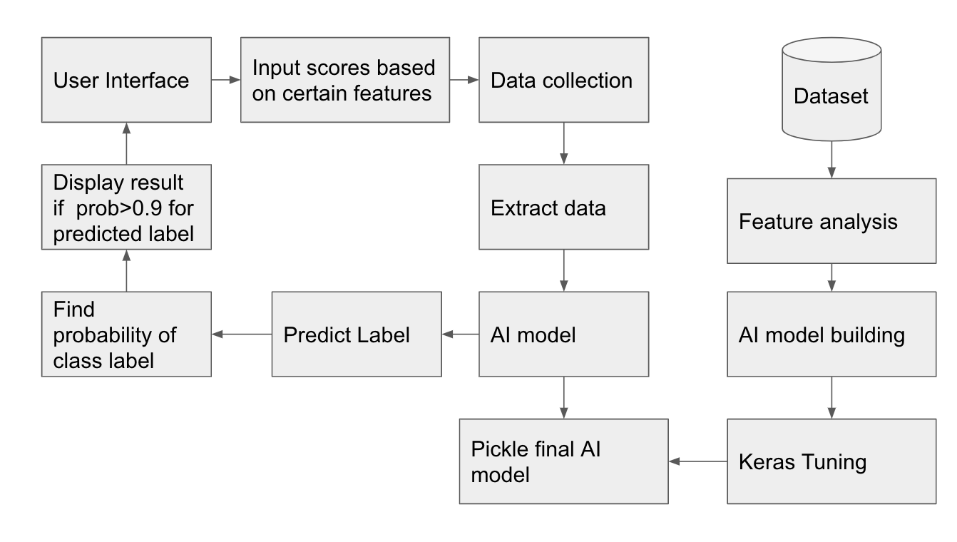
Design
Personality Prediction Using Machine Learning
Figure 1: System Architecture
PVG's College of Engineering and Technology & G. K. Pate (Wani) Institute of Management, Pune.

Slide 11
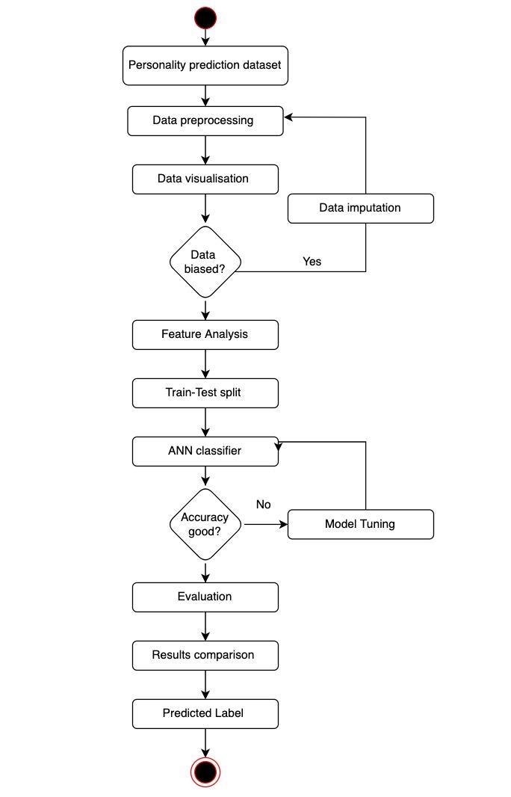
Personality Prediction Using Machine Learning
Figure 4: Activity Diagram
PVG's College of Engineering and Technology & G. K. Pate (Wani) Institute of Management, Pune.

Slide 12
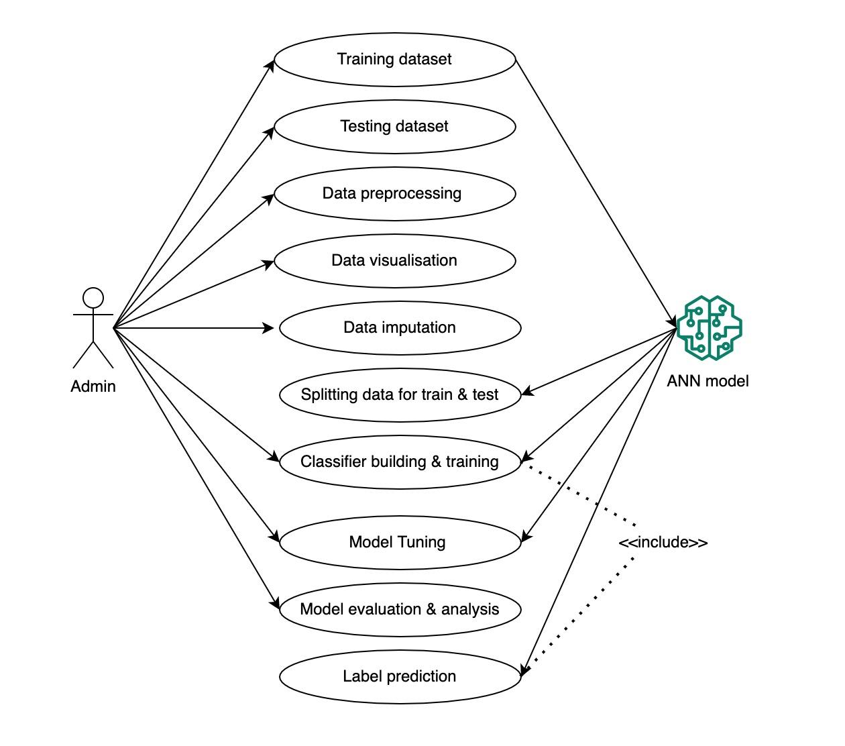
Personality Prediction Using Machine Learning
Figure 3: Use Case Diagram
PVG's College of Engineering and Technology & G. K. Pate (Wani) Institute of Management, Pune.

Slide 13
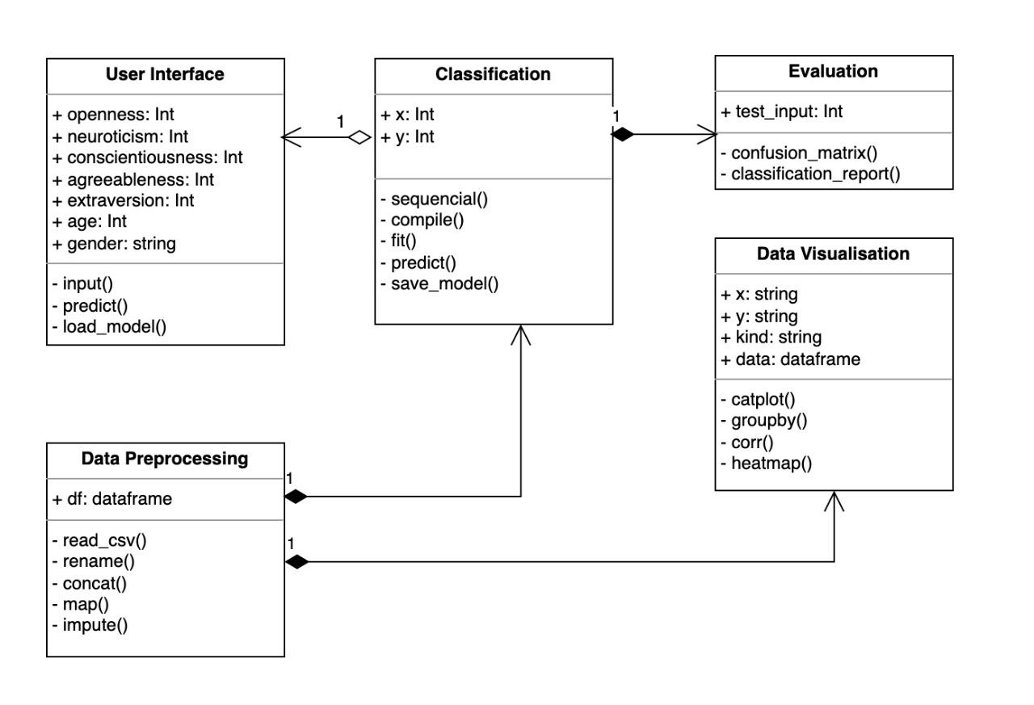
Personality Prediction Using Machine Learning
Figure 2: Class Diagram
PVG's College of Engineering and Technology & G. K. Pate (Wani) Institute of Management, Pune.

Slide 14
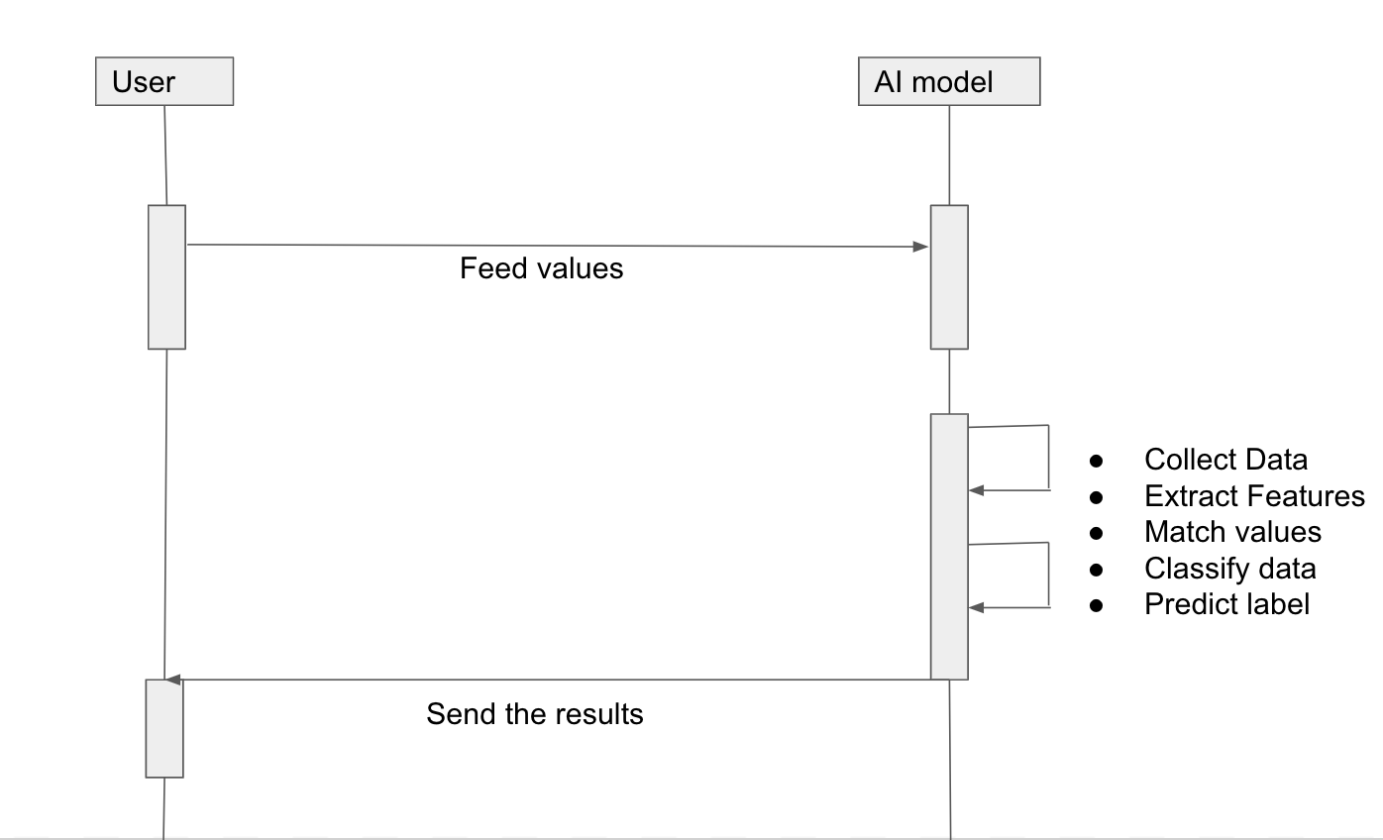
Personality Prediction Using Machine Learning
Figure 5: Sequence Diagram
PVG's College of Engineering and Technology & G. K. Pate (Wani) Institute of Management, Pune.

Slide 15
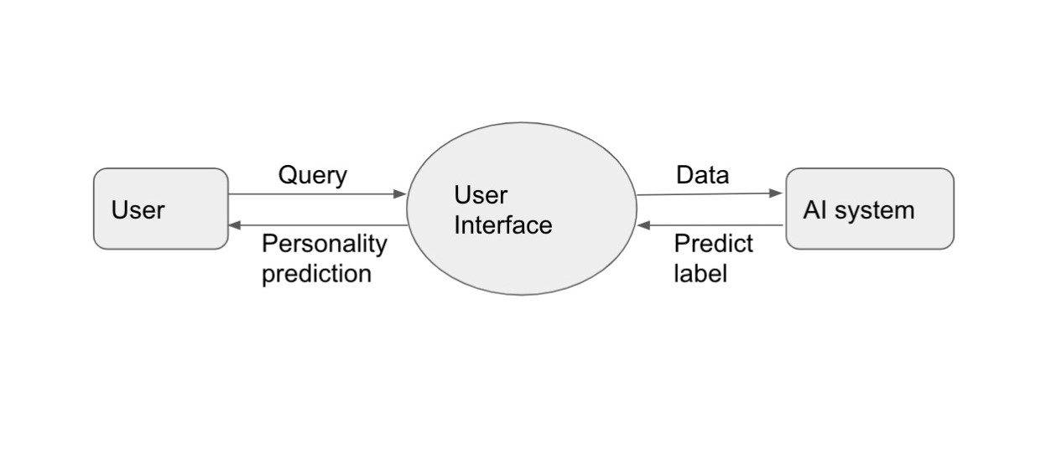
Personality Prediction Using Machine Learning
Figure 6: Data Flow Diagram
PVG's College of Engineering and Technology & G. K. Pate (Wani) Institute of Management, Pune.

Slide 16
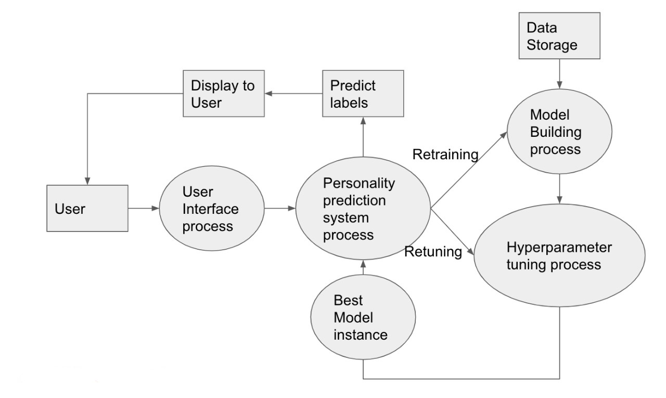
Personality Prediction Using Machine Learning
Figure 6: Data Flow Diagram
PVG's College of Engineering and Technology & G. K. Pate (Wani) Institute of Management, Pune.

Slide 17
Personality Prediction Using Machine Learning
Implementation
Dataset acquisition.
Importing libraries ex NumPy, pandas, matplotlib etc.
Loading the Dataset.
Handling missing values.
Feature Scaling.
Extracting important information from data.
Python will be used as a development language.
Model building and Training.
Model tuning.
User Interface.
PVG's College of Engineering and Technology & G. K. Pate (Wani) Institute of Management, Pune.

Slide 18
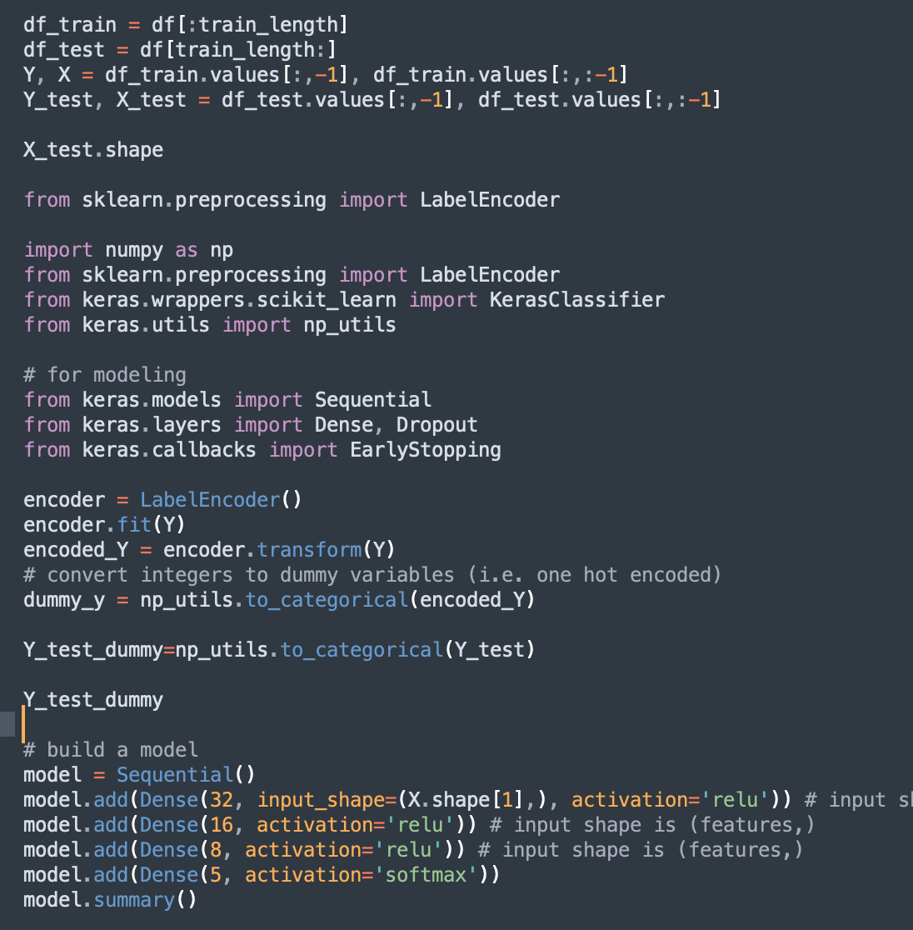
Personality Prediction Using Machine Learning
Implementation
Sample Code of ANN Model.
PVG's College of Engineering and Technology & G. K. Pate (Wani) Institute of Management, Pune.

Slide 19
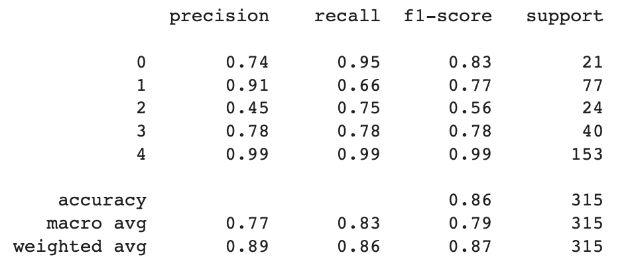
Personality Prediction Using Machine Learning
Result
After Model tuning and refinement, we get the final model that can be used for predictions on unseen data. The accuracy for the final model reaches up to 86%.
Confusion Matrix of final AI model :-
PVG's College of Engineering and Technology & G. K. Pate (Wani) Institute of Management, Pune.

Slide 20
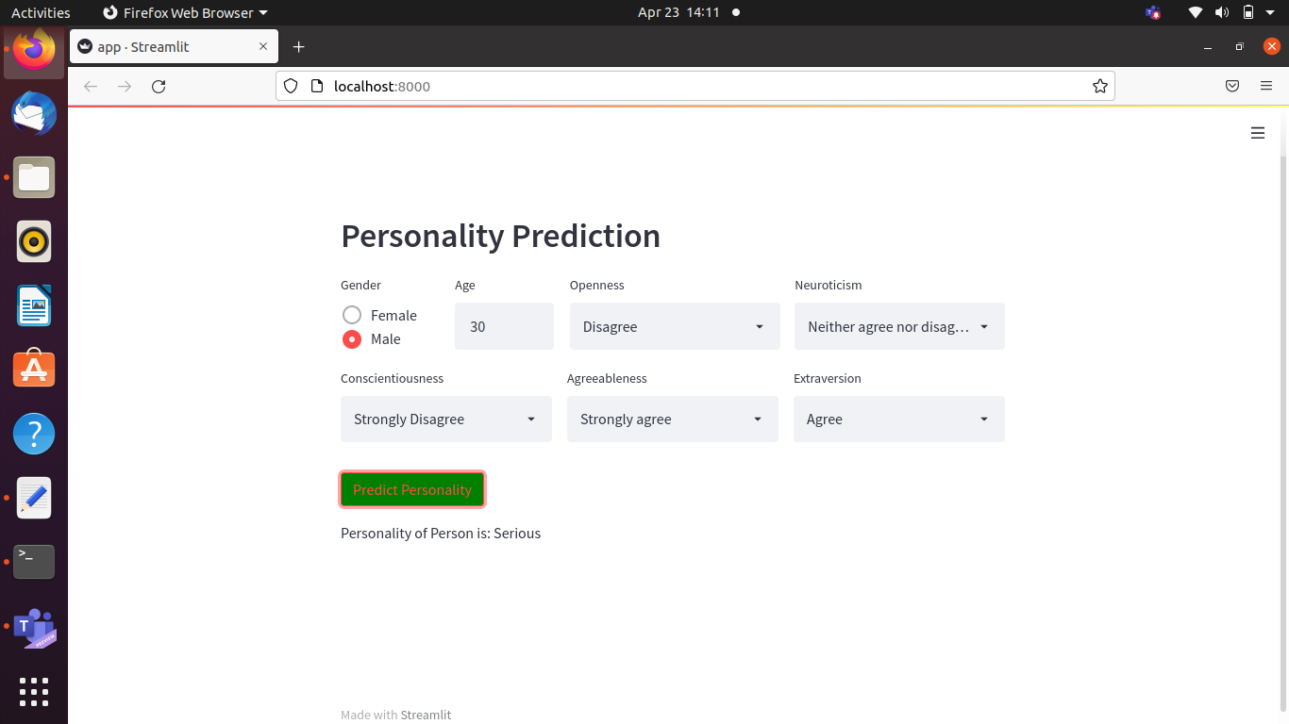
Personality Prediction Using Machine Learning
Result
The final User interface was developed using Streamlit which looks as follows.
PVG's College of Engineering and Technology & G. K. Pate (Wani) Institute of Management, Pune.

Slide 21
Personality Prediction Using Machine Learning
Conclusion
The system will help the HR department to select the right candidate for a job. This in turn will provide expert workforce for the organization. The recruiter need not sort through thousands of resumes. The recruiter enters a score and the personality trait output is the basis of selecting or rejecting a resume.We will make use of deep learning based ANN algorithms to train our AI model and they have high time complexity. The system can be integrated with the recruiting company‘s existing website. Thus, the genuineness of the employer is guaranteed as the system is part of the company's official website. The system would be used in many business sectors that
will require expert candidates, thus reducing the workload on the human resource department.
PVG's College of Engineering and Technology & G. K. Pate (Wani) Institute of Management, Pune.

Slide 22
Personality Prediction Using Machine Learning
References
[1] T. Yarkoni, “Personality in 100,000 words: A large-scale analysis of
personality and word use among bloggers,” J. Res. Pers., vol. 44, no. 3, pp. 363–373, 2010
[2] F. Celli, “Mining user personality in twitter,” Lang. Interact. Comput. CLIC, 2011.
[3] I Ilke, W Peter, Personality and Job Engagement. Journal of Personnel Psychology 2011; 10: 177-181.
[4] D Tantam, The machine as psychotherapist: impersonal communication with a machine. BJP synch
Advances 2017.
PVG's College of Engineering and Technology & G. K. Pate (Wani) Institute of Management, Pune.

